Slide 1
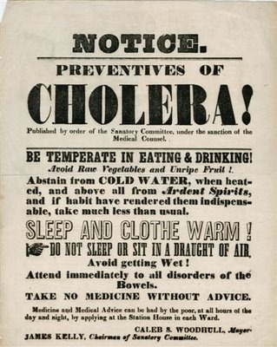
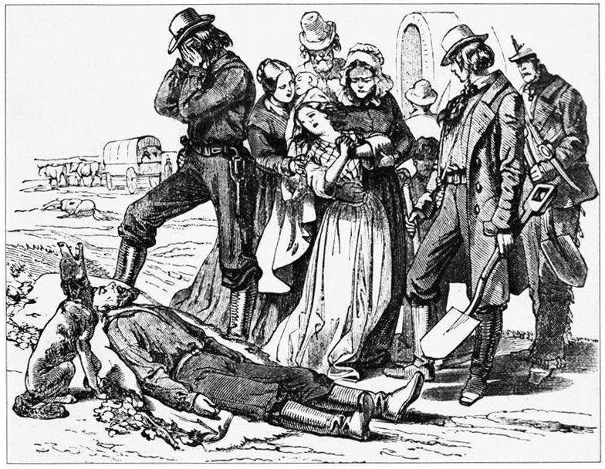
Nashville Cholera Epidemic 1849-1850
Brochure

Slide 2
Cholera Related Death numbers of the Summer of ‘49 and ‘50

Slide 3
Urban
Rural

